Slide 1

Cognida Coding Challenge

Slide 2
About the coding challenge
Cognida Coding Challenge (CCC) is a 48-hour hackathon format where the candidates can pick up any one challenge of their choice and come up with their brilliant solutions which would then be evaluated by the Cognida Team across various parameters.
The students would be allowed to have access to internet, but only original work and development would be appreciated and selected for further rounds.
Any candidate selected for further rounds, would go through a rigorous technical evaluation and also a deep dive into their respective code.
Each challenge has a defined submission format. Candidates are required to stick to that format only. NOT adhering to the submission format will result in IMMEDIATE disqualification.
A candidate can also attend more than one challenge but must keep in mind that only complete solutions are accepted in any of the challenge.

Slide 3
Cognida – Coding Hackathon
Challenge 1 – Mineral Processing

Slide 4

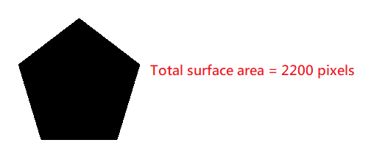
Mineral Processing Technology – Image Analytics
In the field of Mineral Processing Technology, size analysis of the various particles of an extracted sample is of importance in determining the quality of minerals, entropy values and in establishing the degree of liberation of the values from the gangue at various particle sizes.
In this problem statement, candidate is required to analyze the mineral particles in the input folder and calculate the following -
The smallest circle that just encapsulates the particle (the circle has to be generated on the image).
Example –
2. Total surface area of the particle (in pixels) (Has to be generated on the image)
Example –

Slide 5

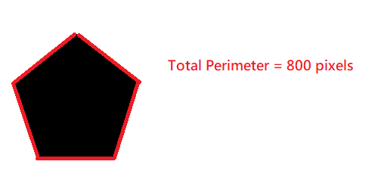
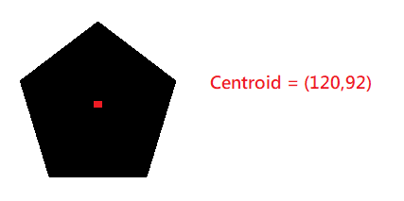
3. The major axis (longest axis) in the particle that lies entirely inside the particle (in pixels) (Has to be generated on the image)
Example –
4. Total perimeter of the particle (in pixels) (Has to be generated on the image)
5. Centroid of the particle (Has to be generated on the image)

Slide 6
Candidates need to write a script in the language of their choice to read the input images for the challenge form the “input” folder, process each image based on the calculations mentioned and save the output image in the “output” folder.
Images are essentially matrices, and all kinds of matrix operations will work on them. Students can learn about how to interprete the images using opencv and then apply their logic to solve the problems. (Refer to tutorials - https://www.geeksforgeeks.org/opencv-python-tutorial/)
Each calculation mentioned above carries equal weightage of marks.
The candidates need to submit the following inside a zip folder with name format (<CollegeName>_<StudentID>_<FirstName>_<LastName>_CCC_MinTech.zip) –
“input” folder – Already provided
“output” folder – Image outputs for each of the image inside the input folder
“code” folder – Code file/files

Slide 7
Cognida – Coding Hackathon
Challenge 2 – E-commerce Platform

Slide 8
Problem Statement
"Build an e-commerce platform for a sustainable fashion brand. Create a user-friendly interface where customers can browse through various eco-friendly clothing items, filter products by different criteria, and add items to their shopping cart. Implement a dynamic shopping cart that displays the total price, and allows for quantity adjustments. Also, have a history page to see all the historic orders of a user and should also show some analytics like spend categories, most preferred brands, etc in the form of a dashboard.
The developed application should be a Single Page Application.
Use React.js/Angular.js/Vue.js/any other JavaScript framework to develop the application.
You can use any library which can help you in the development of the application.
Participants will be evaluated on the design, responsiveness, implementation of features, and creativity in the user experience of the application.
Provide the complete working code in zipped format - (<CollegeName>_<StudentID>_<FirstName>_<LastName>_CCC_EComm.zip)
The submission should have a folder name "Screenshots" containing screenshots of the working application.
Submission must also contain a README.md file with steps to execute your code .
The application should work in chrome browser and should be responsive.

Slide 9
Cognida – Coding Hackathon
Challenge 2 – Real-time Parking system

Slide 10

Real time parking system
Parking Solutions a parking lot management company is looking to enhance their parking system by adding digitizing the lot management with IoT capabilities and thus making car parking stress free. They currently manage the parking lots manually with no digital media.
Parking Solutions manage parking lots which cater to various vehicle sizes. Each vehicle size attracts different tariff based on an hourly system with first 2 hours a fixed charge and there on an hourly additional charge.
Parking lots can be anywhere between 3 to 12 floors incase of Multilevel parking lots. Parking lots can be open grounds as well
Parking solutions would like to assign a nearest parking lot based on first come first serve basis. The driver would then be instructed to reach to the assigned parking lot number based on visual guidance or they can use a Mobile App for navigational instructions.
Once the vehicle reaches the parking lot, sensors would be fixed on the parking lot which would detect presence of a vehicle above it and reports back to the system which marks the parking lot as filled. The sensor also has the capability to read the Vehicle registration number and validate if the assigned vehicle is being parked at the lot. If an incorrect vehicle is being parked an alarm will be triggered at the parking lot and a alarm notification will be sent to the lot management staff.
A parking lot will be held for 10 mins from the time it has been allotted to a vehicle at the entry gate. If the vehicle isn’t parked within that time frame the parking lot will be released.

Slide 11
Application Requirements
Parking Solutions would want the system to be able to handle multiple parking lots of a different types (MLPL, Flat ground etc.). They would want an admin to be able to create a new Parking lot in the system and create Parking lots based on the type of structure (multiple floors if it is MLPL).
Using the Administration UI, they would like to be able to associate sensors with Parking lot Identification numbers. They should be able to define what types of vehicles can park based on the parking slot sizes available. They should also be able to define tariff per vehicle type.
Lot management staff should be able to use the UI and allocate a parking lot to a vehicle after entering the vehicle registration number and selecting the type of the vehicle (2 wheeler, car, van, truck etc.) at the entry gate.
At the exit gate, based on the vehicle number staff should be able to generate an parking charge slip with the details of the charges and number of hours charged.
System should consider negative scenarios where vehicle leaves the parking lot but doesn’t exit within 10 mins. Staff should be alerted in this scenario.
UI should have a dashboard which will visually show how much of the parking lot is occupied.

Slide 12
Non-functional requirements
The UI should be responsive so that staff can use the system while on the move from Tablet or Mobile devices.
Overall transaction time should be less than 10 seconds to avoid queuing up during peak hours.
Tech stack can be either Open Stack (Java) or Microsoft Stack (.Net)

Slide 13
Deliverables
Solution design document describing technology choices and the rationale behind each.
Component diagram and thought process behind the component breakdown and functionality grouping
Database design and rationale
Fully functional application code and DB schema with instructions on how to deploy.
Application should include Front-end (UI) and back-end
Any 3rd party components which are used should be mentioned with deployment instructions and configuration steps.
The submission has to be in for of a zip file in the following format – (<CollegeName>_<StudentID>_<FirstName>_<LastName>_CCC_RTPS.zip)

Slide 14
Evaluation Criteria
Thorough System design
Code Re-usability
Use of design patterns
Completeness of the solution

